Slide 1
Pretrained Models and NLP Tools
Heming XIA
2025.2.11

Slide 2
Outline
History of Pretrained Models
Transformer Structures
Bert

Slide 3
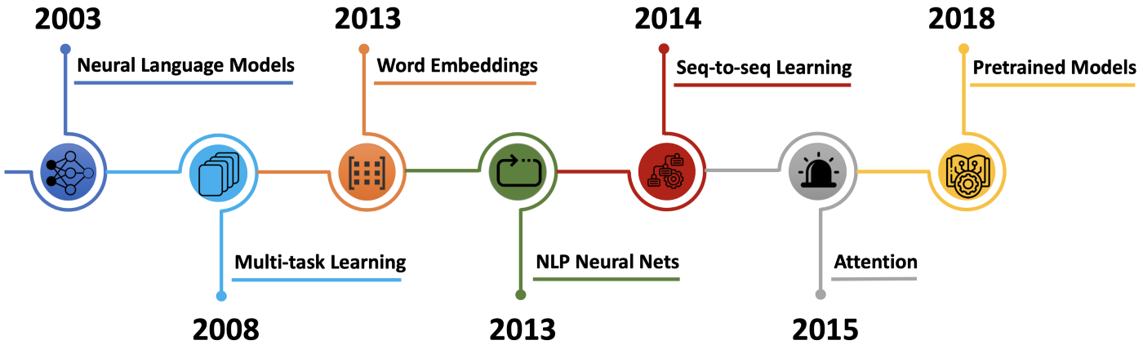
Pretrained Models Since GPT
2017: Transformer
(GPT, BERT)

Slide 4
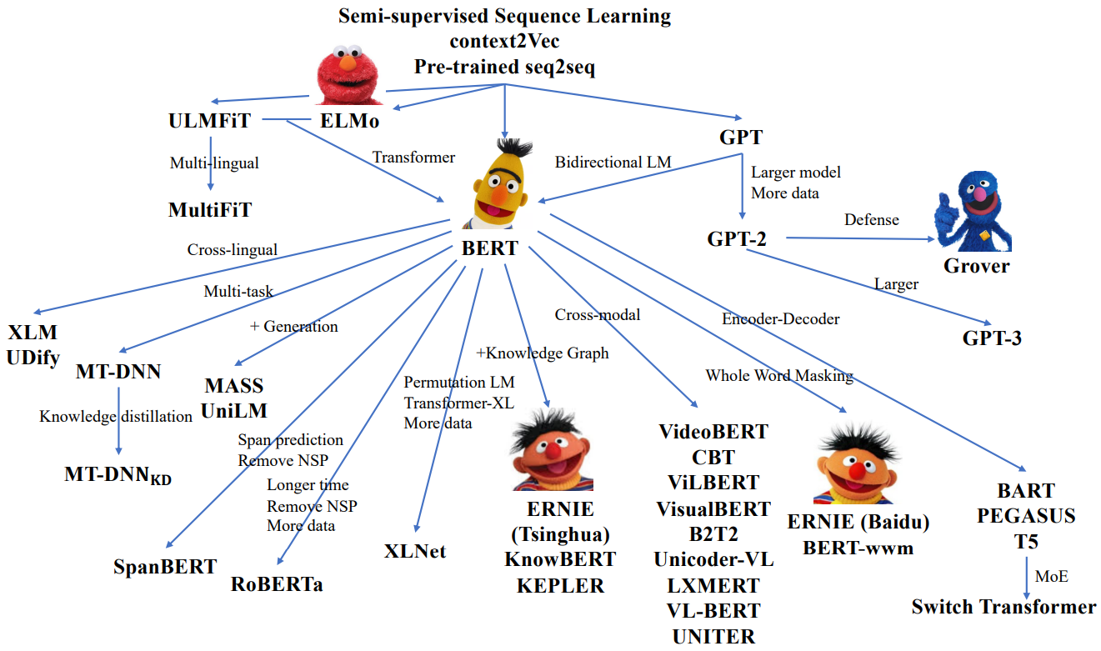
Pretrained Models Since GPT
2018 – 2020:

Slide 5
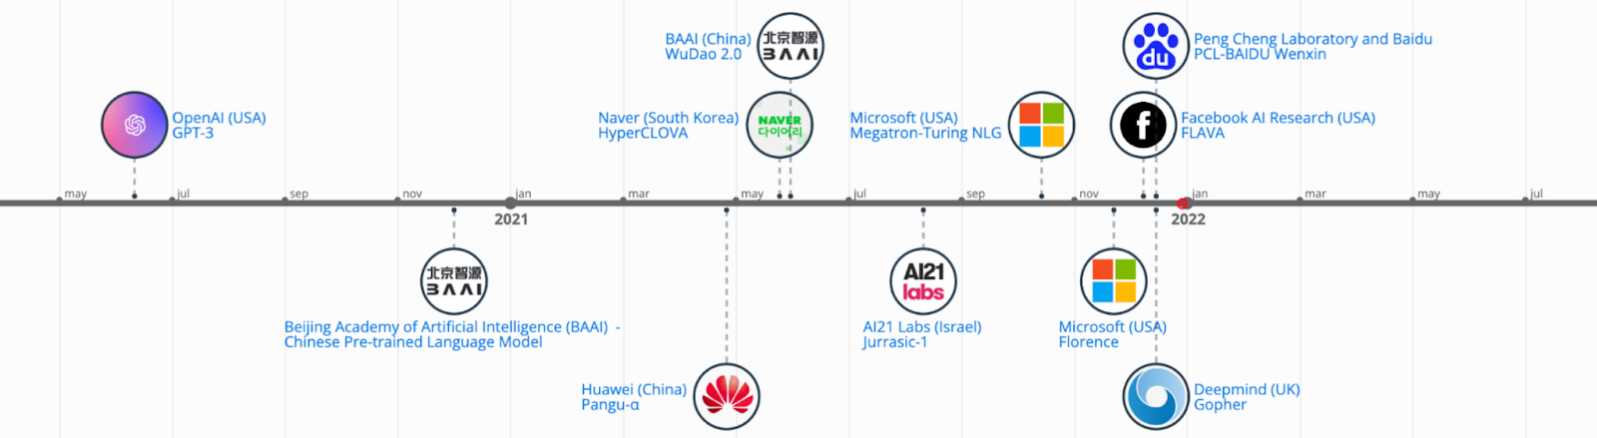

Pretrained Models Since GPT
2020 – Present:
Nov, 2022
ChatGPT

Slide 6
Transformers (Google, 2017) — Basic architecture of pretrained language models
Vaswani et al., Attention Is All You Need. NIPS (2017)

Slide 7


A High-Level Look
Transformer was first proposed to address machine translation, where it takes a sentence in one language, and output its translation in another.
Notes:
French - English

Slide 8

A High-Level Look
The encoding component is a stack of encoders
The decoding component is a stack of decoders of the same number

Slide 9
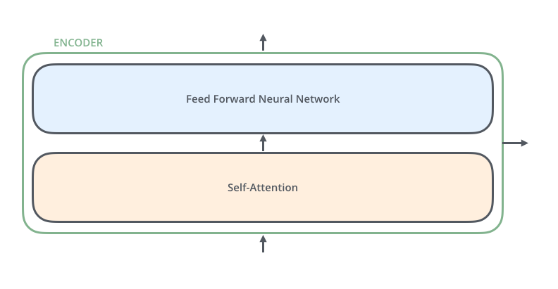
A High-Level Look
The encoders are all identical in structure (yet they do not share weights)
Each encoder layer is broken down into two sub-layers
The encoder’s inputs first flow through a self-attention layer, i.e., a layer that helps the encoder look at other words in the input sentence as it encodes a specific word.

Slide 10

A High-Level Look
Each decoder has both those sub-layers, but between them is an encoder-decoder attention layer
The encoder-decoder attention (also called cross attention) layer helps the decoder focus on relevant parts of the input sentence.

Slide 11
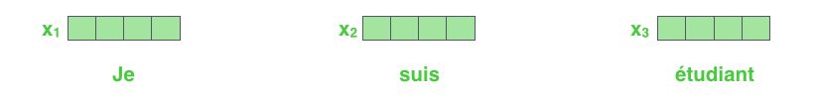
Bringing Words into Tensors
As is the case in NLP applications in general, we begin by turning each input word into a vector using an embedding algorithm.
The embedding only happens in the bottom-most encoder
In other encoders, it would be the output of the encoder that’s directly below
Each word is embedded into a vector of size 512. We'll represent those vectors with these simple boxes.

Slide 12
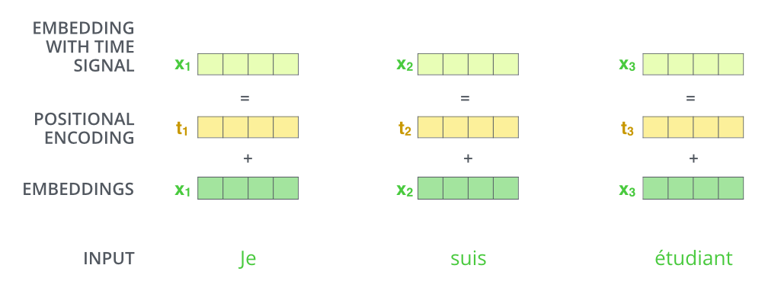
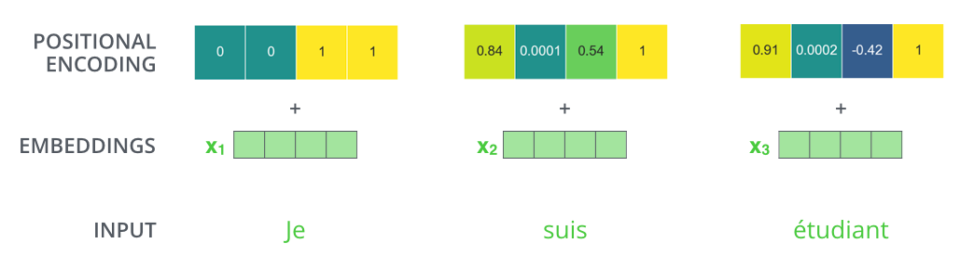
Bringing Words into Tensors
Transformer represents the order of the input sequence using positional encoding
To give the model a sense of the order of the words, we add positional encoding vectors (the values of which follow a specific pattern, e.g., sine and cosine functions).

Slide 13
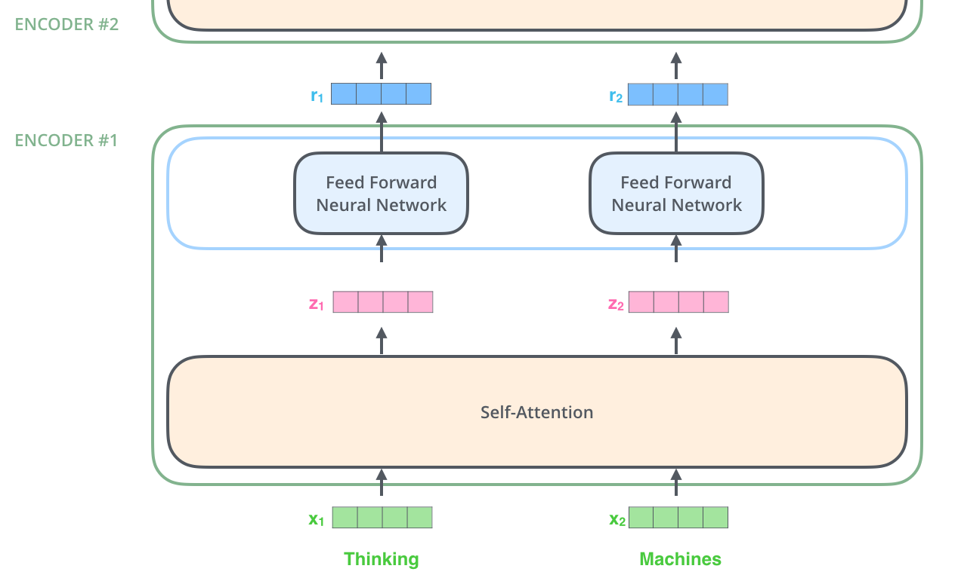
Bringing Words into Tensors
After embedding the words in our input sequence, each of them flows through each of the two layers of the encoder.

Slide 14

Self-Attention at a High Level
Consider the following sentence, an input sentence we want to translate:
“The animal didn't cross the street because it was too tired”
When the model is processing the word “it”, self-attention allows it to associate “it” with “animal”.
Key idea: As the model processes each word (each position in the input sequence), self attention allows it to look at other positions in the input sequence for clues that can help lead to a better encoding for this word.

Slide 15

Self-Attention in Detail
Let’s first look at how to calculate self-attention using vectors.
Step 1: create the “query”, “key”, and “value” vectors from each of the encoder’s input

Slide 16
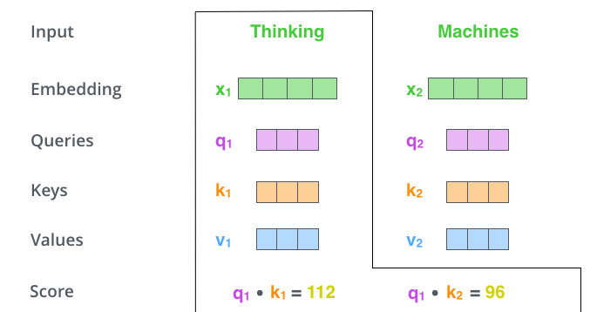
Self-Attention in Detail
Step 2: calculate a relevance score by taking the dot product of the query vector with the key vector of the respective word
For the word in position #1, the first score would be the dot product of q1 and k1, the second score would be the dot product of q1 and k2, and so forth …

Slide 17
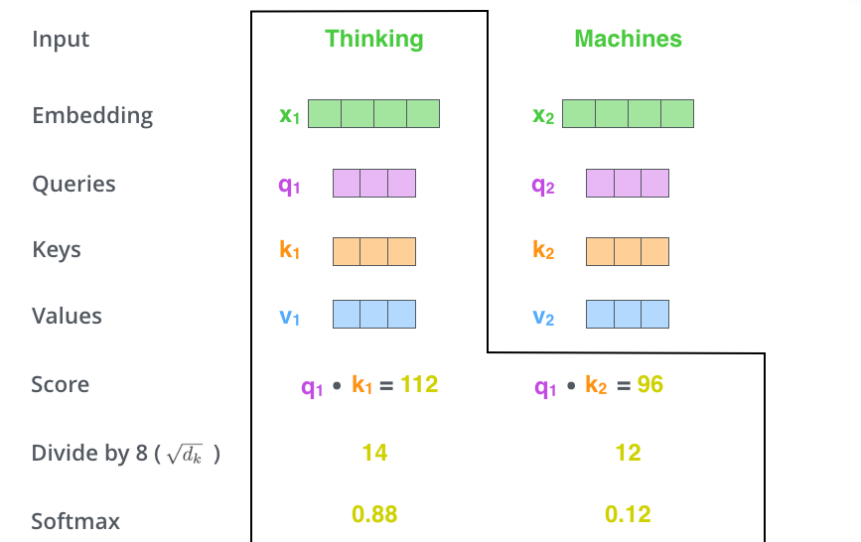
Self-Attention in Detail
Step 3: divide the scores by the square root of the dimension of the key vectors (scaling)
Step 4: normalize the scores so they’re all positive and add up to 1 (softmax)

Slide 18

Self-Attention in Detail
Step 5: multiply each value vector by the softmax score (to keep intact the values of the word(s) we want to focus on, and drown-out irrelevant words)
Step 6: sum up the weighted value vectors

Slide 19
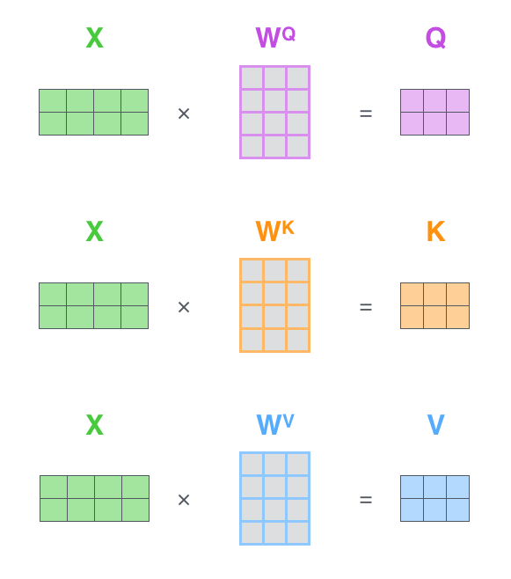
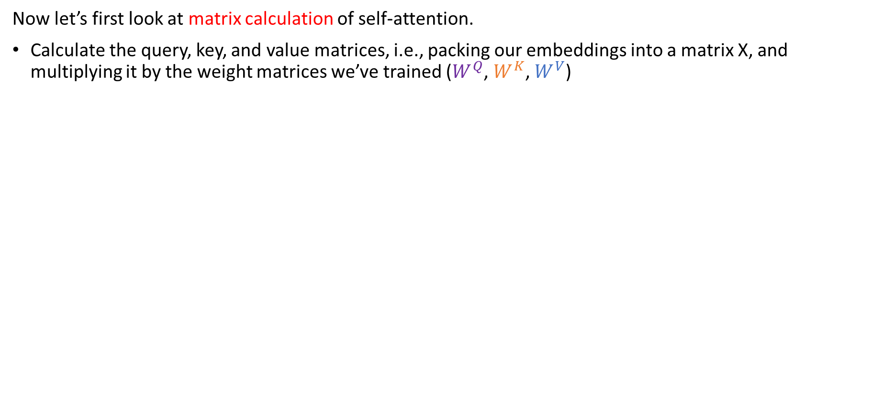
Self-Attention in Detail
Now let’s first look at matrix calculation of self-attention.
Calculate the query, key, and value matrices, i.e., packing our embeddings into a matrix X, and multiplying it by the weight matrices we’ve trained ($W^{Q}$, $W^{K}$, $W^{V}$)
Every row in the X matrix corresponds to a word in the input sentence.

Slide 20


Self-Attention in Detail
Now let’s first look at matrix calculation of self-attention.
Calculate the query, key, and value matrices, i.e., packing our embeddings into a matrix X, and multiplying it by the weight matrices we’ve trained ($W^{Q}$, $W^{K}$, $W^{V}$)
Condense steps 2-6 in one formula to calculate the outputs of the self-attention layer

Slide 21

Self-Attention with Many Heads
Multi-head Attention Mechanism:
It expands the model’s ability to focus on different positions.
It gives the attention layer multiple “representation subspaces”.

Slide 22

The Residuals
One detail we need to mention before moving on, is that each sub-layer in the encoder has a residual connection around it, and is followed by a layer-normalization step.

Slide 23

The Decoder Side
The output of the top encoder is then transformed into a set of attention vectors K and V, which are then passed to the decoder.
(watch the GIF)

Slide 24

The Decoder Side
The decoder repeats the following steps until a special symbol is reached, indicating that it has completed its output.
(watch the GIF)

Slide 25
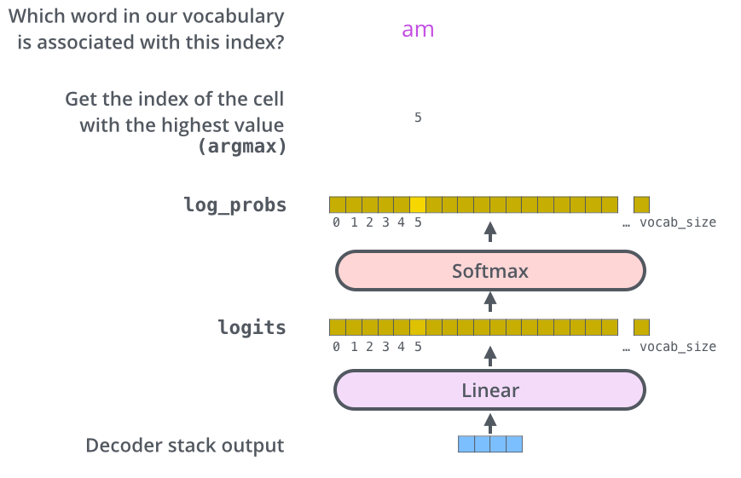
The Final Linear and Softmax Layer
The decoder stack outputs a vector of floats. How do we turn that into a word?
The Linear layer is a simple fully connected neural network that projects the vector produced by the stack of decoders, into a much larger vector called a logits vector.
The Softmax layer then turns those scores into probabilities.

Slide 26
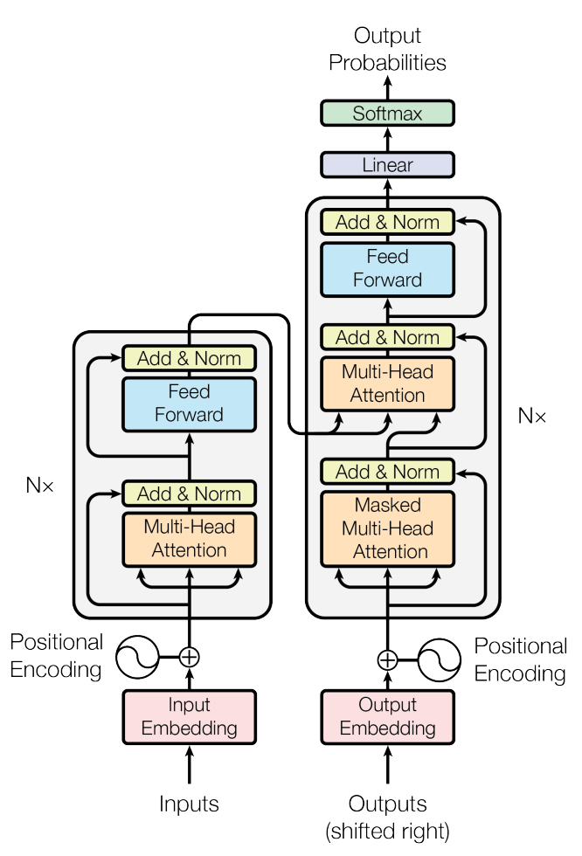
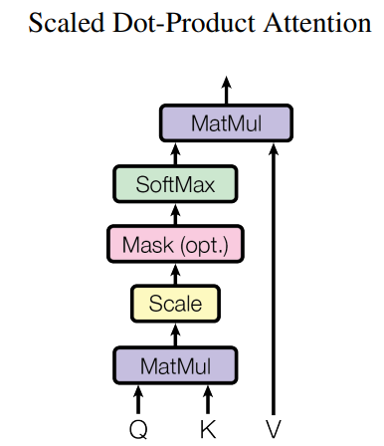
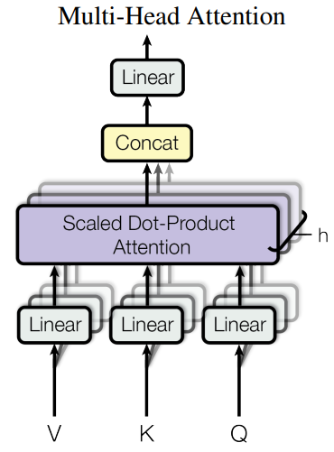
Overview in the Original Paper
Vaswani et al., Attention Is All You Need. NIPS (2017)

Slide 27
BERT (Google, 2018/2019) — Most well-known bidirectional pretrained language model
Devlin et al., BERT: Pre-training of Deep Bidirectional Transformers for Language Understanding. NAACL (2019), Best Long Paper

Slide 28
A High-Level Look
BERT is a model that broke several records for how well pre-trained models can handle language-based tasks.
The release of BERT is an event described as marking the beginning of a new era in NLP (It enables pre-training + fine-tuning be the mainstream paradigm in NLP).
BERT builds on top of a number of clever ideas that have been bubbling up in the NLP community, including but not limited to semi-supervised sequence learning, ELMo, ULMFiT, generative pre-training, and the Transformer.

Slide 29
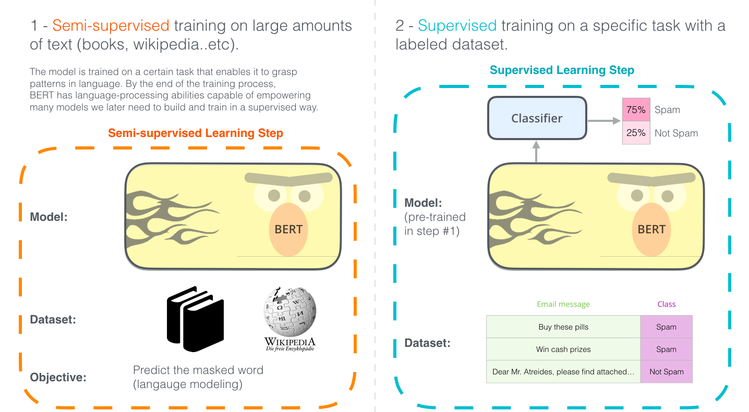
A High-Level Look
How does BERT work?

Slide 30
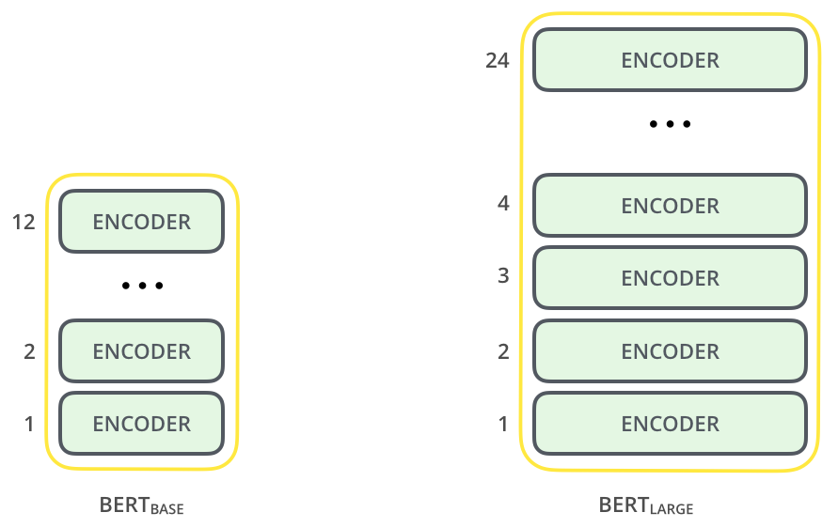
Model Architecture
BERT is basically a trained Transformer encoder stack:
BERT Base: 12 layers, 768 hidden units, 12 attention heads (110M params)
BERT Large: 24 layers, 1024 hidden units, 16 attention heads (340M params)

Slide 31
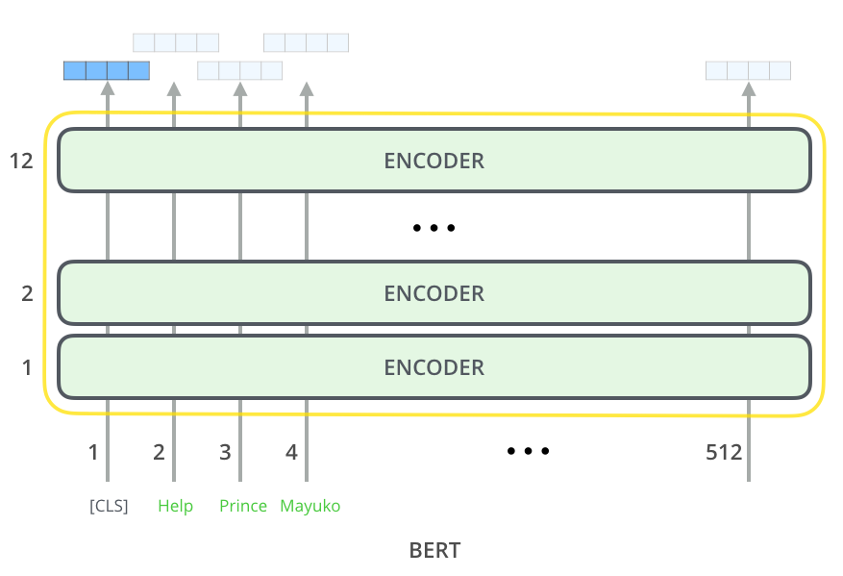
Model Inputs and Outputs
Inputs: Just like the vanilla encoder of the transformer, BERT takes a sequence of words as input which keep flowing up the stack.
Outputs: Each position outputs a vector of size hidden_size (e.g., 768 in BERT Base).

Slide 32
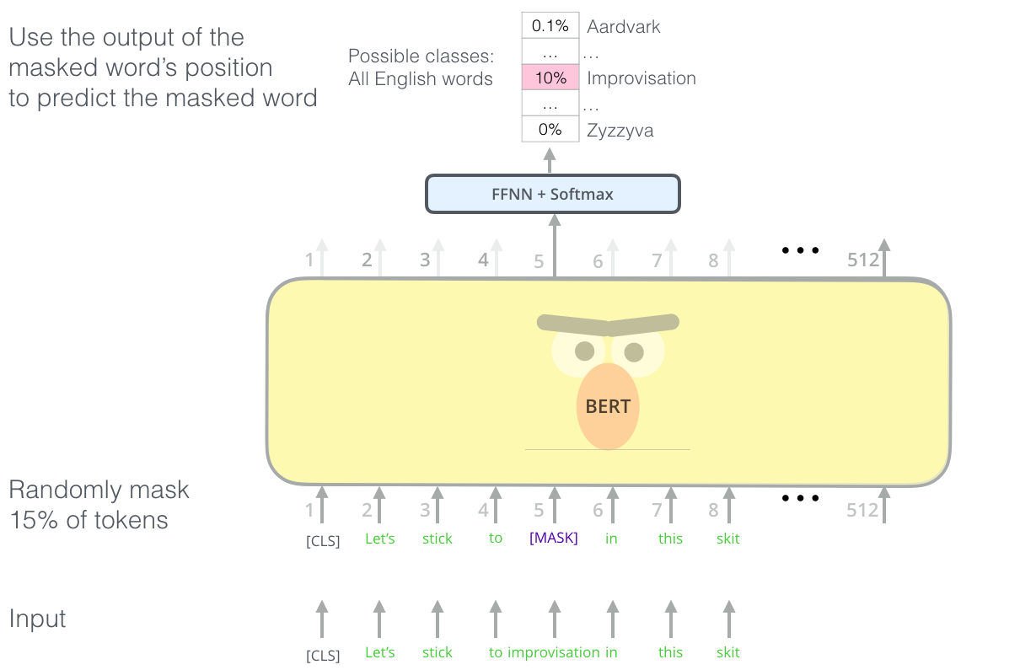
Pre-training
Task #1: Masked Language Modeling (MLM)

Slide 33
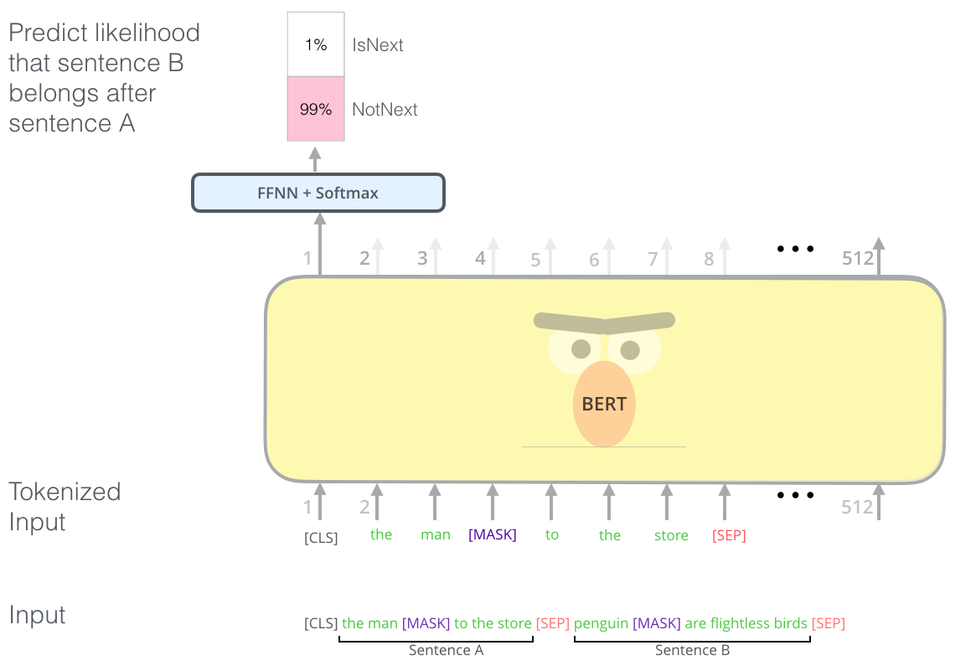
Pre-training
Task #2: Next Sentence Prediction (NSP)

Slide 34
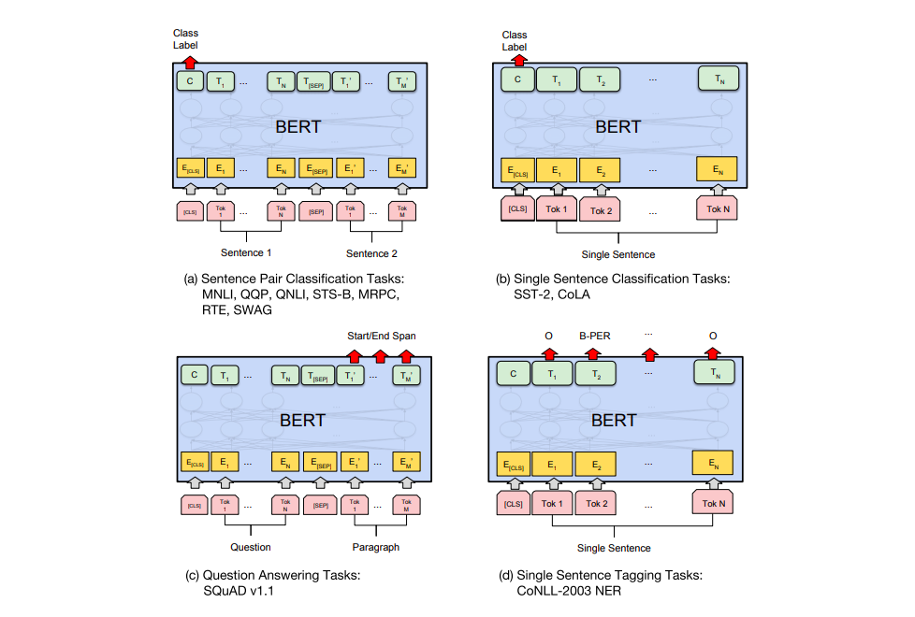
Task-specific Fine-tuning
Finetuning: simply plug in the task-specific inputs and outputs into BERT and finetune all the parameters end-to-end
Sentence Pair Classification
Single Sentence Classification
Single Sentence Tagging
Question Answering

Slide 35
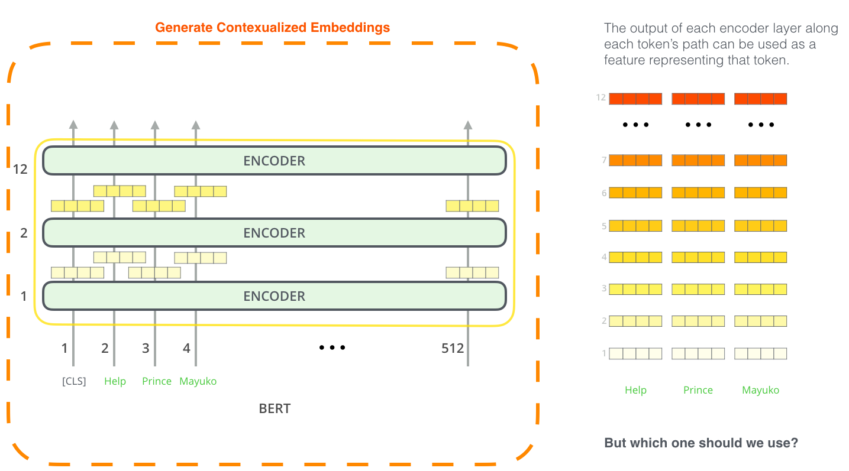
BERT for Feature Extraction
The fine-tuning approach isn’t the only way to use BERT.
We can use the pre-trained BERT to create contextualized word embeddings, then feed these embeddings to solve many downstream tasks by own design (e.g., add additional layers).

Slide 36
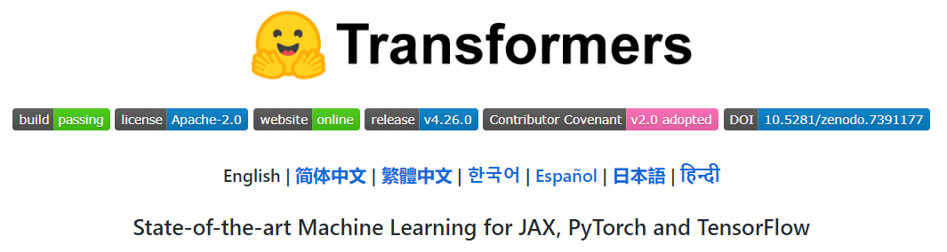
Demonstration
Huggingface Transformers:
Source code: https://github.com/huggingface/transformers
Models: https://huggingface.co/models
Now let’s play with BERT base model!
Please visit the page https://huggingface.co/bert-base-uncased

Slide 37
Reference
[1] Vaswani et al., Attention Is All You Need. NIPS (2017)
[2] Jay Alammar. The Illustrated Transformer. Alammar’s Blog (2018) https://jalammar.github.io/illustrated-transformer/
[3] Devlin et al., BERT: Pre-training of Deep Bidirectional Transformers for Language Understanding. NAACL (2019)
[4] Jay Alammar. The Illustrated BERT, ELMo, and co. Alammar’s Blog (2021) https://jalammar.github.io/illustrated-bert/

Slide 38

10-min Break

Slide 39
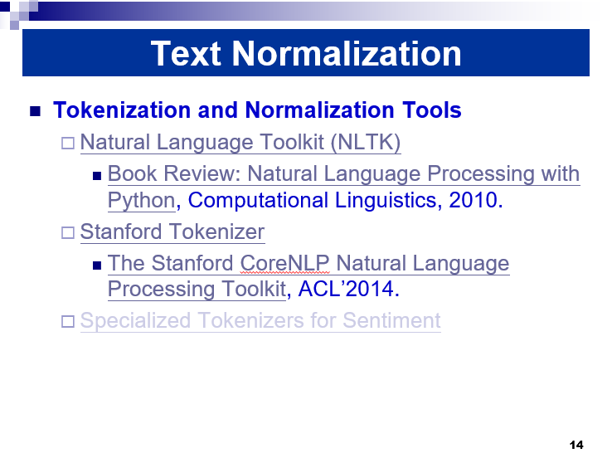
Outline
NLTK
Gensim
BERT
Image source: Lecture2 Page14

Slide 40
Expected Outcomes
Implement:
Segmentation/Tokenization (Lecture2)
Part of Speech Tagging
Stemming and Lemmatization (Lecture2)
Vectorization and Document Similarity Calculation (Lecture2)
Sentence Classification (Lecture3)

Slide 41
Materials
Download the following files from BlackBoard:
lab1_codes.ipynb
lab1_data.zip
lab1_documentation.pdf

